Slide 1

Thoughts on Gaming Systems and Architectures
Gaming Systems Consists of Three Primary Parts
The User Interface: Actually this consists of the game visual interface and a method for the player to put information into the game
The Visual State Interface: This is a graphic of the State of the Game
The Simulation Driving the Game. This simulation is normally an abbreviated time step Architecture
Games can be either Single or Multiple Player. In all cases the simulation “game loop” follows this set of Steps
For this Game Play
For Each Player Decide Action this play (move, hide, engage, etc)
Move All movers
Adjudicate actions of each Player
Graphic Visual System Showing Game State
Simulation System

Slide 2
Thoughts on Gaming Systems and Architectures
Consider Now Two Knights Fighting. Knights have the following moves they may execute:
1. Lunge 2. Thrust
3. Over Head Bash 4. Slash Right High
5. Slash Left High 6. Slash Right Low
7. Slash Left Low 8. Slash Right Low
9. Block Right High 10. Block Left High
12. Block Right Low 12. Block Left Low

Slide 3
Thoughts on Gaming Systems and Architectures
Consider Now Two Knights Fighting. Knights have the following moves they may execute:
1. Lunge 2. Thrust
(Step forward) (No Step)
3. Over Head Bash 4. Slash Right High
(High then low) (Right Shoulder to Chest)
5. Slash Left High 6. Slash Right Low
(Left Shoulder to Chest) (Right waist to knee)
7. Slash Left Low 8. Block Right High
(Left waist to knee) (Block over Right Shoulder)
9. Block Left High 10. Block Right Low
(Block over Left Shoulder) (Block over Right Knee)
11. Block Left Low
(Block over Left Knee)

Slide 4
Finite State Machine for Knight Object Moves

Slide 5
Finite State Machine for Knight Object Moves Data Structure (Representing the Finite State Diagram)

Slide 6
Consideration of Gaming Strategies Mini-Max Theory
Mini-Max Strategy is the focus of strategies of a two player game
Mini-Max assumes that the game works in the following manner;
The game is between Player 1 and Player 1
Player 1 and Player 2 each select their moves for the next round of play
The moves are made and the results of the moves are assessed
The cycle of select, move and assessment goes again
Mini-Max is a conservative strategy that says, “Considering my current options for my next move, and the options my opponent has for his next move, I will select my move that will minimize the maximum damage my opponent can do to me”

Slide 7
Finite State Machine
Assume that I have just finished a Thrust. Then my next moves can be:
Thrust
Block Left Low
Block Right Low
Assume that My Opponent just finished an Overhead. Then Next Moves can be:
Overhead
Block Left Low
Block Right Low

Slide 8
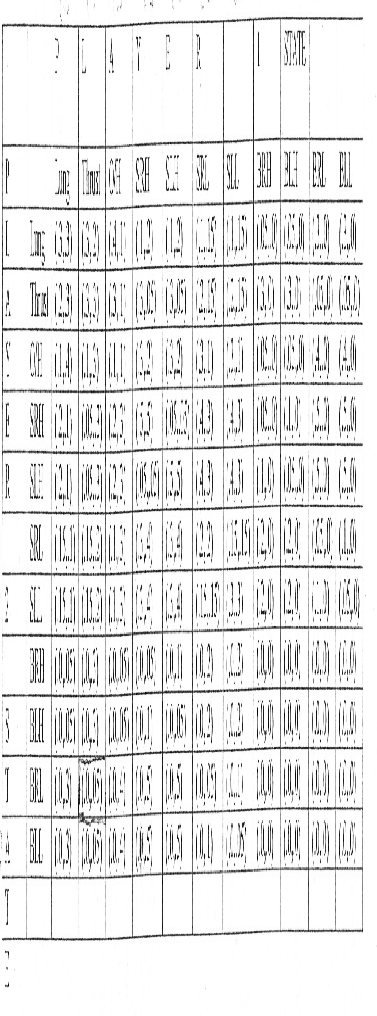



Adjudication Table for Player 1 and Player 2
Entries represent: Given state Player 1 and Play 2 (Prob of kill Player1, Prob of kill Player 2)
For Example Player 1 is Thrust, Player 2 is Overhead (0.1 kill p1, 0.3 kill p2)

Slide 9
Minimax Max Calculation
Assume that P1 has Thrust and P2 has Overhead
P1 Moves with PK
P2 Moves Thrust Block Left Low Block Left High
OV HD 0.1 0.4 0.05
BLK L L 0.05 0.0 0.00
BLK R L 0.05 0.0 0.00
Max PK 0.1 0.4 0.05
Choose Min (Max PK) 0.05 and associated move
NEXT MOVE P1 IS Block Left High !!!!
Assume that I have just finished a Thrust. Then my next moves can be:
Thrust
Block Left Low
Block Right Low
Assume that My Opponent just finished an Overhead. Then Next Moves can be:
Overhead
Block Left Low
Block Right Low

Slide 10
Steps In Computing Next Move with Min/Max Theory
List all the next possible moves I can Make as a table header
List all the next possible moves My Opponent can Make as the table columns
For Each entry in the table select the Prob of Kill of me for that combination
Entry [Op move, My move] = Prob of Kill for Me
4. List the Maximum value for each column of my moves
5. Select the column having the minimum value as my next move.

